Slide 1
Excel reassessment
Lakshmi Kollimarla
4287

Slide 2
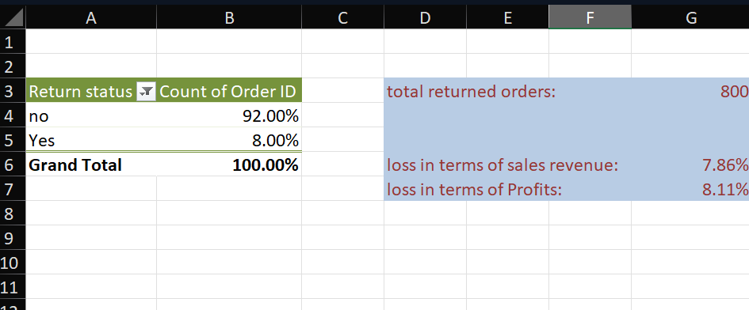
Question 1
Used vlookup to find the return status of each order
Made a pivot table to find the percentage of orders that were returned
Calculated the loss in terms of sales revenue and profits due to returns using sumif and sum
Total of 800 orders are returned
There is a loss of 7.86% in total sales revenue
There is a loss of 8.11% in total
profits

Slide 3
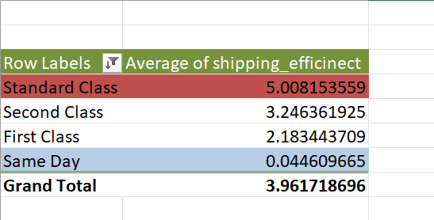
Question 2
- calculated shipping efficiency by days() between ship date and order date
- Made a pivot table and found average shipping efficiency for each shipping mode
- sorted the pivot in descending order based on average
- The Same day shipping mode is the fastest with an average delivery time of 0-1 days
- The standard class is slowest with an average delivery time of 5 days

Slide 4
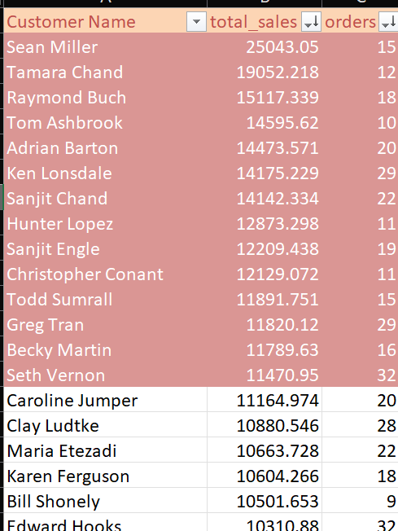
Question 3
Found unique customers from the data
Calculated total sales and number of orders placed for each customer
Sorted the data in descending order based on total sales generated and orders places to get the high value customers
The customers highlighted are the high value customers since revenue is mostly generated from them.
Target marketing can be done by showing the above customers ads relevant to their frequent purchases.

Slide 5
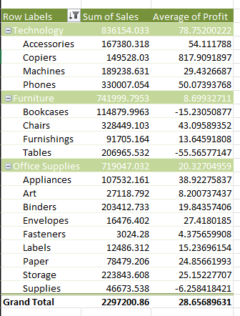
Question 4
- Created a Pivot table and found total sales for each group of category and sub-category
- sorted the data based on total sales to find top selling category and sub category products
- Calculated the average profit for each group from the pivot table
- The top selling groups are:
Technology : Accessories
Furniture : Bookcases
Office Supplies : Appliances

Slide 6
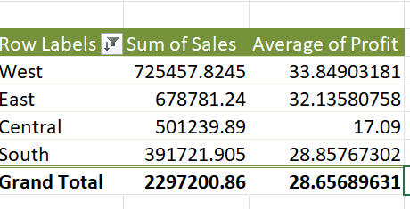
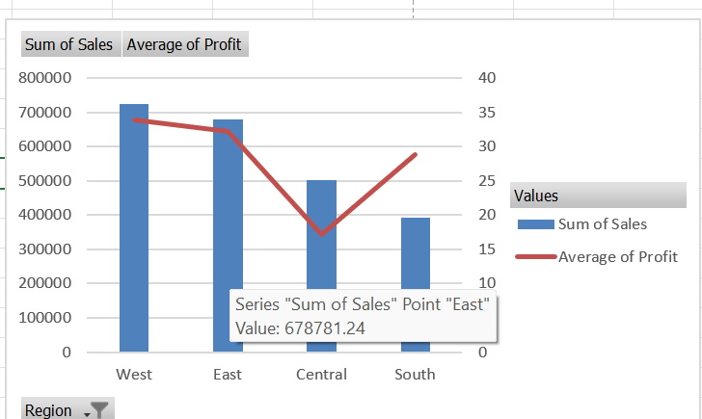
Question 5
-Calculated the total sales and Average profit grouped by region by creating a Pivot table
- sorted the data in descending order on sum of sales.
- The region with highest sales is west
- The region with lowest sales is south
- The profit margins took a considerable dip in the central region and are high in west region

Slide 7
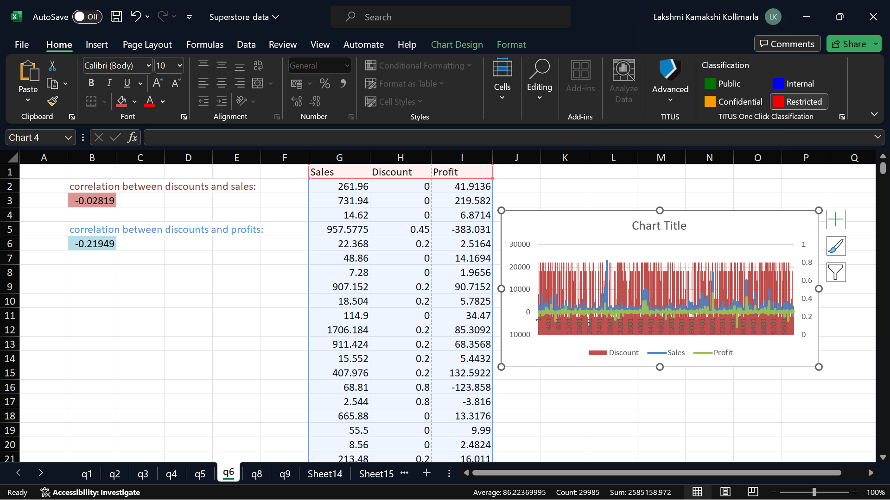
Question 6
Used the correl() formula to find the correlation coefficient between discounts and sales , discounts and profits.
The correlation coefficient for discounts and sales : -0.028
Since it is considerably low, we can say there is no correlation between discounts and sales
The correlation coefficient for discounts and profits is -0.21949
The coefficient is still low, but can be considered as negative correlation.

Slide 8
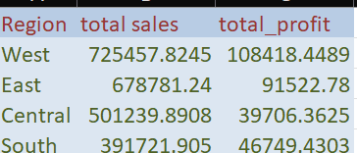
Question 7
Calculated region wise total sales and total profit
It is observed that south is not yet saturated and is low in total sales
Calculated customer wise total sales and number of order
Observed that Cassandra Brandow is a target customer and she is from south
Hence, improving sales in south region will improve overall sales and profits
Person | Region | total_sales | orders
Cassandra Brandow | South | 287.99 | 9
Anna Andreadi | West | 6076.139 | 26
Kelly Williams | Central | 449.096 | 5
Chuck Magee | East | 5086.935 | 18

Slide 9
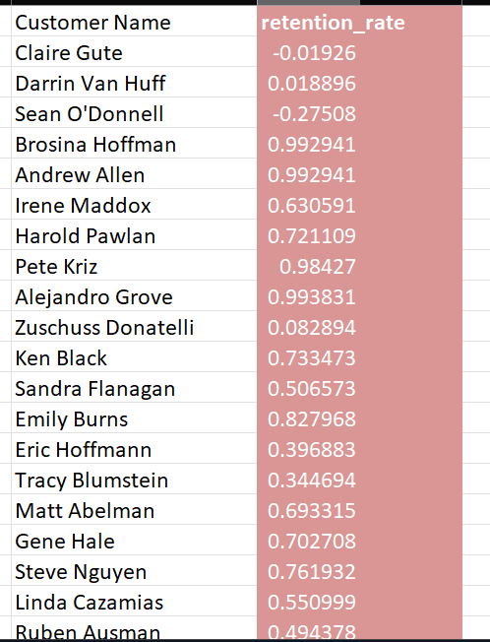
Question 8
- calculated total sales for every year for each customer
- calculated the retention rate for each customer
- customers with positive retention rate should be given loyalty program discounts for more life time
- customer with negative retention rate are likely to stop making purchases, giving discounts and sales would help to increase their life time

Slide 10
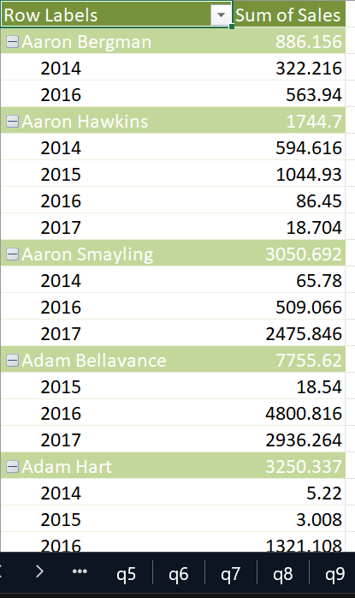

Slide 11
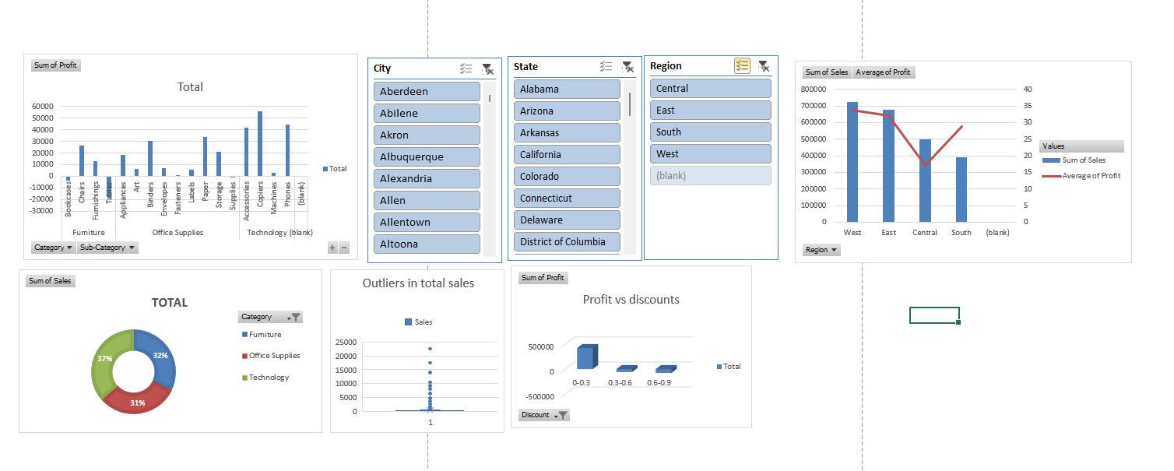
Dashboard

